Slide 1

The impacts of state sponsored cyberterrorism and how to prevent them
By: ASNAI NARANG (AN23612)
Notes:
The impacts of state sponsored cyberterrorism and how to prevent them by Asnai Narang

Slide 2

What is Cyberterrorism?
Notes:
Lets start with what is cyberterrorism? According to the research by (Riglietti, 2016), there were two main interpretations of Cyber terrorism. The first interpretation is that an attack that involves a computer as a main or only weapon, can be considered a cyberterrorism attack. The second interpretation is, the concept where machine is used as a tool by terrorists to plan attacks.

Slide 3
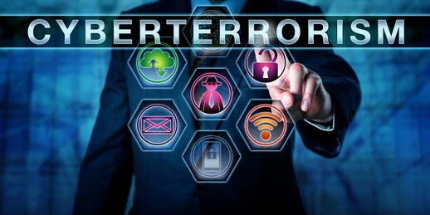
Key Literature
Cyber Security and International Conflicts: An Analysis of State-Sponsored Cyber Attacks (Azubuike, 2023)
Notes:
The key literature used in this presentation is Cyber Security and International Conflicts: An Analysis of State-Sponsored Cyber Attacks. (Azubuike, 2023)

Slide 4
Research Methodology
Articles
Books and Reports related to cyber security and international politics
3. Official government
documents.
(Azubuike, 2023)
Notes:
The research methodology that was used was reviewing different articles, books and reports that relate to cyber security and international politics between 2010 and 2023. The research also included official government documents, international agreements and policies that had connections to cybersecurity and international politics. (Azubuike, 2023)

Slide 5

Aim and Objectives
Notes:
The aim and objective of this research is to analyze the different impacts that state sponsored cyberterrorism can have using past records and suggesting ways that can prevent such attacks from occurring.

Slide 6

State sponsored cyber attacks ​
German Parliament attack 2015 (Courtney, 2017)
Notes:
Lets focus on some of the state sponsored attacks that have occurred before. First, the attack that occurred in the German parliament in the year 2015. In this attack roughly 20,000 computers that were operated by German staff and operators were impacted causing them to send confidential data to hackers. It required millions of Euros to clean the systems. Even though Russian government never admitted responsibility, the fact that the russian hackers asked the Germans to stop providing support to Ukraine, it was assumed that Russian Intelligence was some how involved as well. (Courtney, 2017)

Slide 7
State sponsored cyber attacks ​
2. The 2014 Sony Pictures hack. (Azubuike, 2023)
Notes:
Another attack that occurred was the sony pictures hack in the year 2014. This attack was assumed to be done by north korea, to protest the release of a film which showcased their leader in bad light. This attack caused heavy financial damage and the reputation of Sony pictures took a big hit. The incident also caused a diplomatic row between the United states and north korea. (Azubuike, 2023)

Slide 8
Reasons for cyberattacks
Gaining an advantage over a rival. (Mateusz Stafiniak and Wojciech Wodo, 2022)
Stealing confidential data.
Notes:
As seen in the previously mentioned cases, there can be varying reasons for why a state can perform cyber attacks. One reason is to gain an advantage over a rival country. (Mateusz Stafiniak and Wojciech Wodo, 2022). Another reason could also be to gain access to sensitive information.

Slide 9
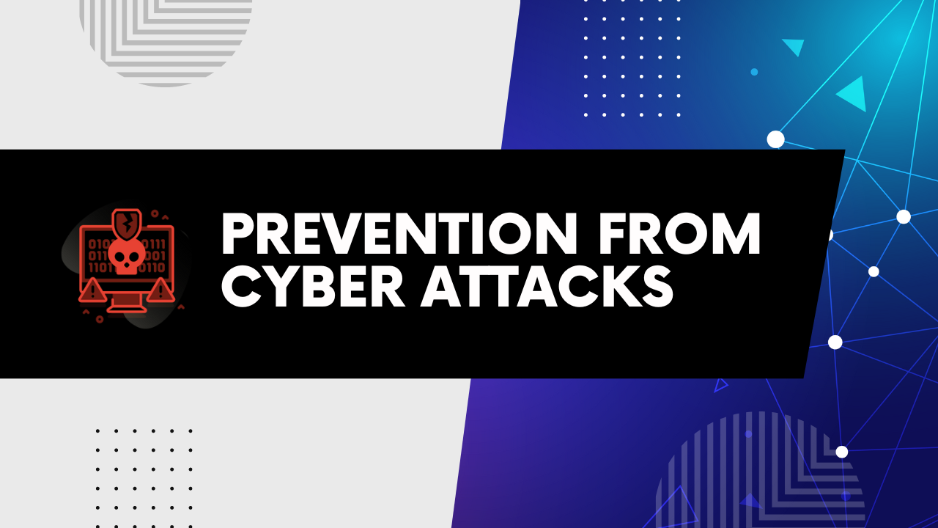
Recommendations
Develop international standards for cyber security
Increase cooperation between countries.
Use of diplomatic measures such as Sanctions.
(Azubuike, 2023)
Notes:
There are a few ways recommended by Azubuike (2023). Firstly, International norms should be developed, to increase the understanding of cyber threats. This was also emphasized by Courtney (2017). The next point is to increase cooperation, between countries to allow resource sharing which can improve the response to cyber attacks. The last recommendation is to use different measures such as sanctions to hold the state accountable and make sure the sanctions have an impact on them.

Slide 10
THANK YOU
Notes:
Thank you.

Slide 11
References
Reference:
Azubuike, C.F. (2023). Cyber Security and International Conflicts: An Analysis of State-Sponsored Cyber Attacks. Nnamdi Azikiwe Journal of Political Science, [online] 8(3), pp.101–114. Available at: https://najops.org.ng/index.php/najops/article/view/70.
Courtney, M. (2017). States of cyber-warfare. Engineering & Technology, 12(3), pp.22–25. doi:https://doi.org/10.1049/et.2017.0300.
Mateusz Stafiniak and Wojciech Wodo (2022). State-sponsored Cybersecurity Attacks. State-sponsored Cybersecurity Attacks. doi:https://doi.org/10.1109/itms56974.2022.9937131.
Riglietti, G. (2016). Defining the threat: what cyber terrorism means today and what it could mean tomorrow. The Business and Management Review, [online] 8(3). Available at: https://cberuk.com/cdn/conference_proceedings/2019-07-18-05-40-33-AM.pdf [Accessed 15 Jul. 2024].
Notes:
Lets start with what is cyberterrorism? According to the research by (Riglietti, 2016), there were two main interpretations of Cyber terrorism. The first interpretation is that an attack that involves a computer as a main or only weapon, can be considered a cyberterrorism attack. The second interpretation is, the concept where machine is used as a tool by terrorists to plan attacks.

